Slide 1

Thesis Topic: Pneumonia Detection using deep learning in healthcare
Name: Syed Nazmus Sakib
ID: 1602022
Faculty of Computer Science and Engineering
Patuakhali Science and Technology University

Slide 2
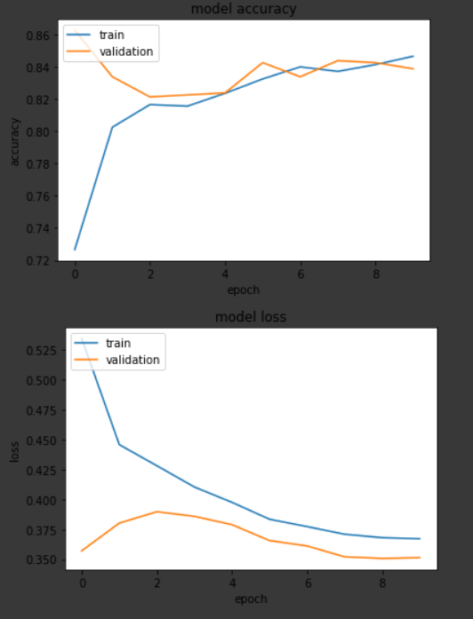
What Has been done so far:
Separated the chosen dataset (RSNA chest Xray Dataset) in three groups.
Male Posterior to Anterior (PA)
Female PA
Male-Female PA
We trained Densenet121 and Resnet101 models on these datasets and tested on our
local dataset of 129 images.
Densenet121 model trained on Male-Female PA dataset has worked best for our local data.
In our local data, we collected our ground truth from 3 separate doctors. In some cases, their
verdicts were different. For 48 images, they had the same verdict.
For these 48 images, our model has correctly predicted all the
positive cases (where patient has pneumonia) but failed to correctly predict some cases
where patient doesn’t have pneumonia .

Slide 3
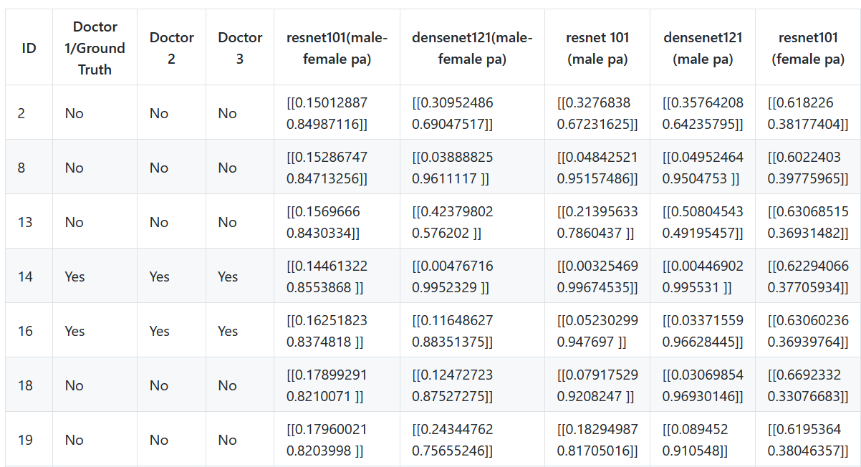
Local test data ( male - female) that contain all yes or all no from 3 doctors for a chest x ray image, truth and prediction table is given below:
For some wrongly predicted positive cases, the probability score of “yes” was relatively low (But still more than 50%).
In the Densenet121 model, we set some layers to trainable so the model can recognize more of the chest x ray images. And the accuracy was increased to 70%.
After Some hyper parameter tuning and augmentation, the accuracy of the model can be increased more.

